Slide 1
Topic - E-Commerce
Team Hustlers
Sakshi Bhalla
Shrija Paul
Srest Bafna
Sulaiman Qizilbash

Slide 2
Addressable Market Size & Market Potential (e-commerce) for ABC in India is 11,500 Cr; with an increasing disposable income
India’s Population 140 Crores
Optimistic
Urban Population - 50 Crores
Rural Population -
90 Crores
E-Commerce TAM Funnel
CAGR 36%
Total Addressable Market (2022) – INR 12550 Cr
Urban Internet Users - 30 Crores
(Assumed Internet Penetration – 60%)
Urban E-Commerce Users - 18 Crores
(Assumed E-Commerce Penetration – 60%)
Target Market –
INR 11500 Cr
Normal
CAGR 25%
Market potential in future for bed & bath
Low Income
7 Crores
Middle Income
5 Crores
High Income
6 Crores
ABC’s offerings
Bedsheets
Towels
Avg. Annual Order (bed & bath)
INR 150
Avg. Annual Order (bed & bath)
INR 500
Avg. Annual Order (bed & bath)
INR 1500
Top of Bed
Rugs
Pessimistic
Total Annual Order
INR 1050 Crores
Total Annual Order
INR 9000 Crores
ABC playing in ‘Value for Money’ & ‘Premium’ Segment with
Market Size: 11 Cr.
Market Potential: INR 11500 Cr
CAGR 18%
Total Annual Order
INR 2500 Crores
“Cheap”
“Value for Money”
“Premium”
Market potential
Competitive landscape
Channel strategy
Marketing Strategy
Marketing & KPI
Conclusion
Market Sizing & Market Potential on Appendix 2: Calculation

Slide 3








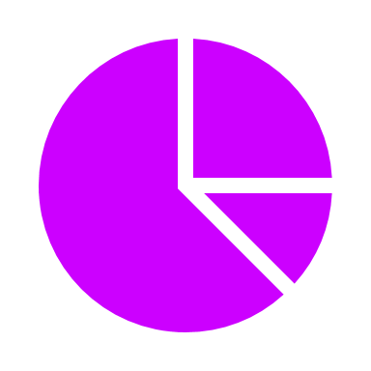













Competitor analysis across various segments reflect gap in premium-niche segment and low recall value of most brands
Segment
“Niche”
“Cheap Alternative”
“Value for money - Mass appeal”
“Niche”
Company
ABC Co.
600-1000+
400-800+
1000-2000+
1000-1600+
600-1500+
800-10,000+
500-4000+
Price of bedsheet ()
700-10,000+
Channel presence
D2C? | ease of use
Brand awareness
Pure-play home textile?
Product range
Bed, bath, OTB
Highly diversified
Bed, bath, yarn
Bed, flooring
Bed, rugs, curtain
Home, Apparel
Bed, bath
Bed, towel, OTB
USP (Consumer need)
Discounts on e-comm
‘s extension
‘s extension
Premium brand
Quality
Eco-friendly
Well established
Global footprint
Quality
-
-
-
E-comm sales %
100%
9%
3%
100%
20%
-
Penetration (Cities)
T1
T1. T2, T3
T1. T2, T3
T1, T2
T1, T2
T1
T1
T1
Delivery time
1 day
5-7 days
5-7 days
2-3 days
4-5 days
5-7 days
5 days
Direct competition
Target segment
What?
Who?
Where?
How?
Premiumize – Display long tail product range
Urban, modern & savvy quality seeker
Metros via D2C, e-comm & stores
Brand positioning as high quality aspirational product
T2 & T3 cities via e-commerce
Market potential
Competitive landscape
Channel strategy
Marketing Strategy
KPI
Conclusion
Appendix 5: Case study Welspun
Appendix 3: Consumer Persona
Source: Annual report, Ecomm sites etc

Slide 4






















Channel strategy – Vision 2025 – D2C integrated into the comprehensive e-commerce ecosystem for synergies
Current mix
Target portfolio
Omni-channel strategy:
New mix
Online
Offline
D2C
E-comm
Online sales – 3%
Online sales – 20%
3%
17%
80%
Others
Others
1
D2C
D2C
Well-functioning platform
Integrating D2C in comprehensive channel ecosystem creates synergies
D2C
High-quality customer service
App
Website
D2C alignment with business model
Customer acquisition to D2C – Abc.com
Optimised product description pages to be Amazon’s choice
Increase search visibility on Google for D2C
Mode
SEO
Redirect from Insta to D2C
Traffic driven
40%
5%
5%
On-ground activation
Discounts on 1st purchase/ bundle discounts
Virtual stores to enhance experience
ABC.com
2
E-comm
- 69% of bed & bath e-comm sales
Strategy I -Focus on
Strategy II - Diverse marketplaces for brand visibility
Boost by integrating:
Over-indexation on Myntra
EBIT erosion due to high discounts on E-comm (5% of ABC compared to 10%)
Before
Bring to fingertips
Microchannels (niche)
E-commerce - Browse through ABC’s catalogue on WhatsApp & order.
Increased traffic on abc.com and Amazon further boost Google rank
Re-shape route to market from retailers to D2C and drive traffic
E-commerce value erosion minimised as dependence on sales/discounts minimised
Pandemic has overall boosted D2C
3
Offline
Focus on Branded & Multistore (1) in Metro cities (2) Prime locations in T2 cities
Premium stores in T3 & below may be uneconomical
Boost sales through all channels to remove over-indexation on Myntra
After
D2C’s impact on ABC’s business model
Low
High
Offline partners for premium band
Focus on high traffic touchpoint and let it seep into D2C - Drive traffic to brand’s Amazon translates to growth
Enhance
Scale
Disrupt
ABC Co.
Market potential
Competitive Landscape
Channel strategy
Marketing Strategy
KPI
Conclusion
Appendix 6: D2C alignment with business model
Appendix 1: Case facts

Slide 5















Digital marketing & rebalancing E-commerce portfolio needed for ABC to boost lacking brand awareness, create a strong brand positioning in home textiles space
Market research
Market strategy for ABC Co.
1
Awareness gap assessment via Primary Research
Aim: Widening digital marketing funnel with Awareness & bundling being growth drivers
Awareness
Consideration
Purchase
Awareness
GAP
 | Need | Search | Attract | Price | Reviews | Compare | UX | D2C
Goal | Awareness generation | Branding & Positioning | Value proposition communication | Cart abandonment to Conversion
Touchpoint | Aspirational Positioning | Search Network | Ads | Online comparison | Reviews | Blogs | D2C | Ecomm
Solution | Influencer Marketing | Google AdWords | Targeted Ads | Bundling Recommendations| Programmatic Advertising ex-Bumper 6s ads & Instream Ads | Showcasing ‘value for money’ or ‘premium quality’ on marketplaces | Certification for quality | Feature on lifestyle blogs & magazines | Directing consumers to website | Improved landing page EX & info availability | Sponsored posts ex - ‘Amazon’s Choice’
Source
Type | Paid Promotion | Earned Promotion | Owned + Paid Promotion
Price perception
>90% of retail customers unaware of bed linen brands except Bombay Dyeing
2
2
Digital Marketing Mix Target v. ABC Strategy
ABC Website
>80% customers start digital searches with
Assumption: Digital Marketing Spendings proportional to digital sales
ABC’s prime focus
Market potential
Competitive landscape
Channel strategy
Marketing Strategy
KPI
Conclusion
Link to Google Form for Primary Research: https://forms.gle/SKiaVxJc1wHgyPW36, Result in Appendix 4

Slide 6



We analysed important KPIs across the unit economics of e-commerce
Unit-economics components (illustrative)
1
3
Net Promoter Score
Conversion Rate
Cost / Conversion
Churn Rate
Time between Purchases
Purchase Frequency
Cost / Click
Average Order Value
Revenue / Visitor
Revenue / Click
Market Share
Product Affinity
New v/s Returning Customer Orders
Sales – Hourly / Daily / Weekly etc.
Customer Lifetime Value
Shopping Cart Abandonment Rate
Generic : Top-line revenue & Profitability
4
Cycle Time
Overall Equipment Effectiveness
Overall Labour Effectiveness
Inventory Levels & Turnover
Lead Time
Refund & Return Rate
2
Referral Sources
Subscriber Growth Rate
Social Media Engagement
Bounce Rate
Active User Engagement Metrics
Pageviews / Session
Traffic – Website & Mobile Site
Customer Retention Rate
5
Customer Satisfaction Score
Hit Rate
Customer Service Email Count
First Response Time
Average Resolution Time
G&A
Competitive landscape
Marketing Strategy
KPIs
Market potential
Channel strategy
KPI
Conclusion

Slide 7
Conclusion
Increase Awareness & brand positioning
Deploy D2C to build internal capabilities
Rebalance E-commerce Portfolio
Monitor KPI’s to maintain dynamism
1
2
3
Fill awareness gap
Jump on the D2C
wave
Rebalancing e-commerce portfolio
A holistic digital channel for increasing brand awareness
Reduce dependence on mainstream channels
Improve product visibility on Amazon/Flipkart (lion’s share of sales)
Accentuating brand image & presence for better recall
Align & build capabilities for D2C creating a robust business model
Integrating different channels to create comprehensive synergies
Improving Engagement & Conversion
Improving Brand Image & Presence
Reducing current dependence on Myntra
Market potential
Competitive landscape
Channel strategy
Marketing Strategy
KPIs
Conclusion

Slide 8
Thank You

Slide 9
Appendix 1: Case facts
Exhibit 1
Exhibit 2
Exhibit 3
Exhibit 4
Exhibit 3
Channel | Category | INR <400 | INR 400-600 | INR 600 – 800 | INR 600 -800 | INR 1000+
Amazon | Bedsheets | - | - | 20% | 35% | 45%
 | Towels | 20% | 25% | 25% | 10% | 20%
Flipkart | Bedsheets | - | - | 40% | 10% | 50%
 | Towels | 15% | 30% | 25% | 155 | 15%
Myntra | Bedsheets | - | 5% | 35% | 20% | 40%
 | Towels | 40% | 35% | 5% | 10% | 10%

Slide 10
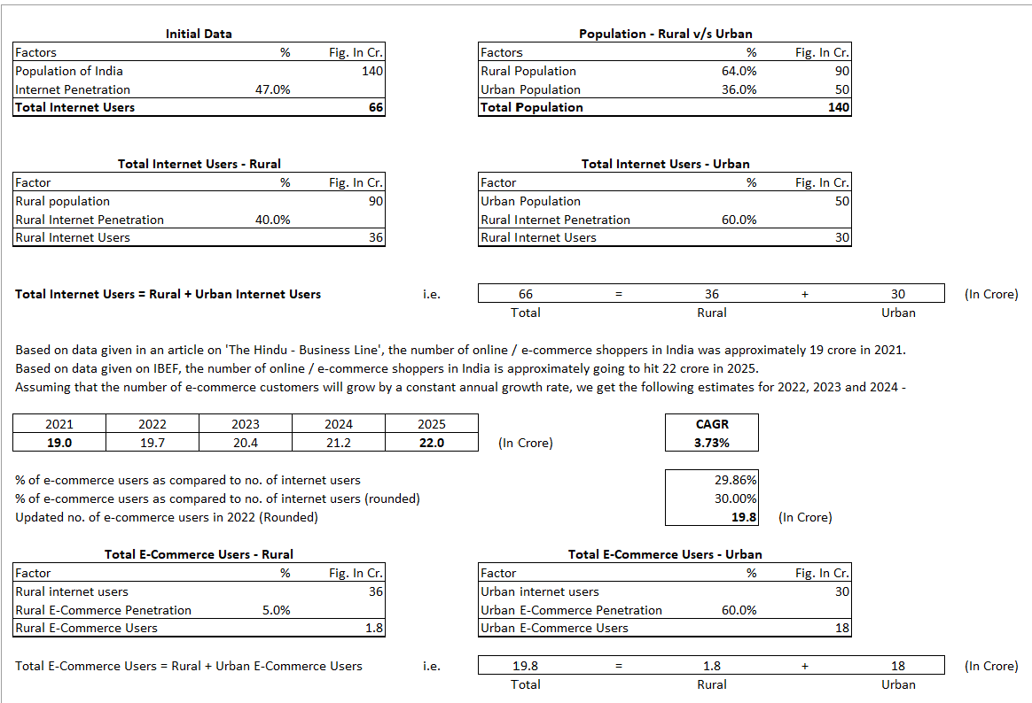
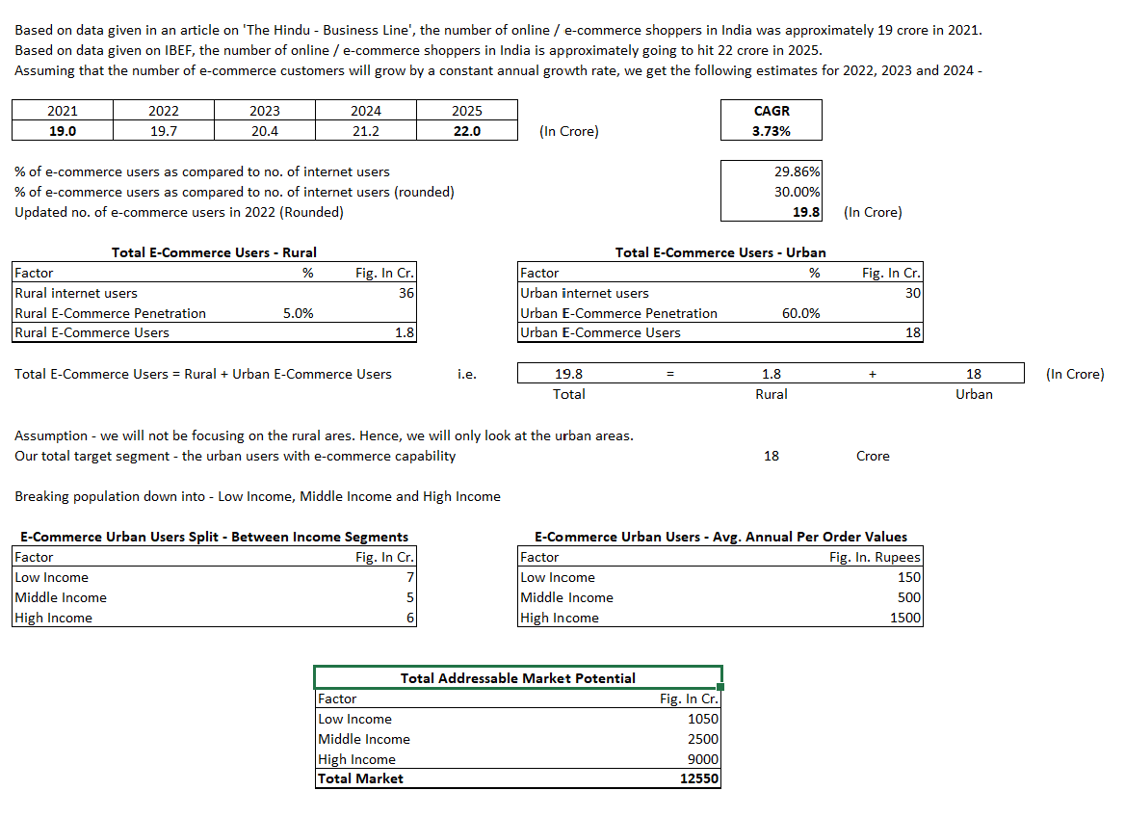
Appendix 2 – Market sizing
Part I 1
Part II 1
Link to Excel Market Sizing Estimate.xlsx

Slide 11

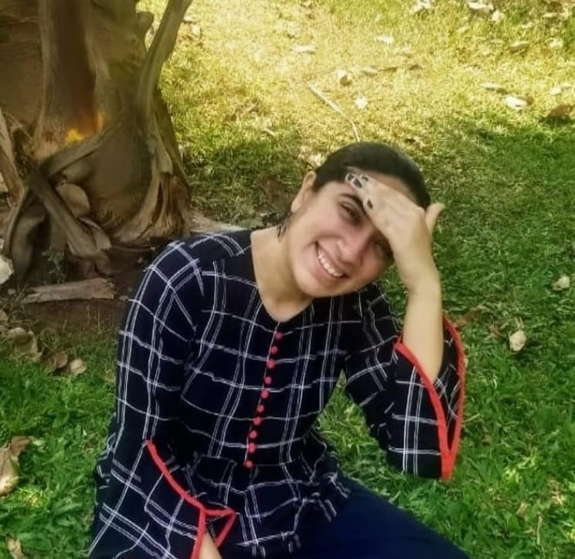
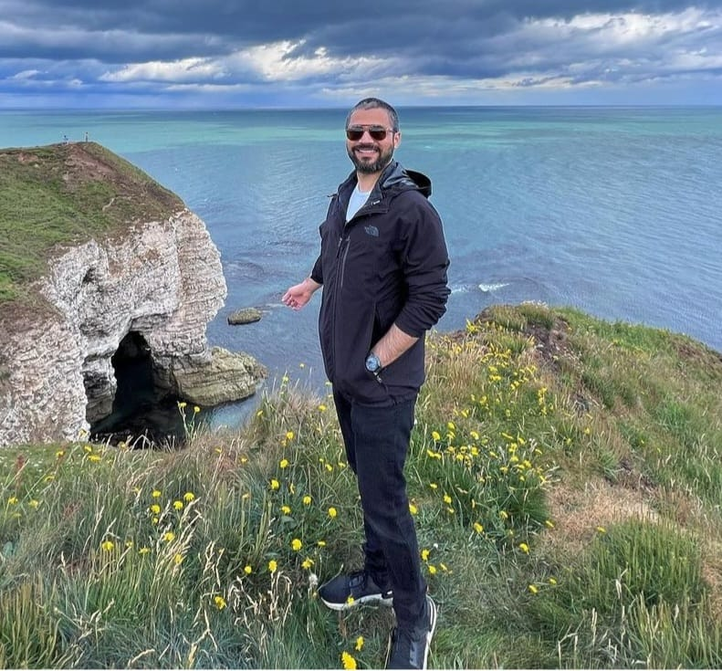
Appendix 3: Primary Research | Customer persona in Bed & Bath category
Customer Persona 1
Customer Persona 2
Customer Persona 3
The ‘It should go with my room'
The ‘I want value for money'
The ‘Maximum comfort consumer'
Customer Persona 1
“Focused on style, type and overall theme of the room”
“How does it look? How fast can it deliver? Do I trust the brand?”
“I generally focus on softness, look, is it fitted or not? Is it a good brand or not?”
Dev Banerjee
“Focused on style, type and overall theme of the room”
Demography
Gender- Male | Age- 26yrs | From -Lucknow
Demography
Gender- Female | Age- 25yrs | From - Mumbai
Demography
Gender- Male | Age- 32yrs | From – Delhi
Product Focus
Style, Price, Sustainability, Room Aesthetics
Product Focus
Demography
Gender- Male | Age- 26yrs | From -Lucknow
Comfort, Pattern, Delivery time
Product Focus
Product feel, Premium Brand
Price Range
Rs. 500 – Rs. 1500
Price Range
Rs. 400 – Rs.1000
Price Range
Rs. 1000+
Product Focus
Style, Price, Sustainability, Room Aesthetics
Channel Focus
Offline Stores – Westside
Online – Google
Channel Focus
Online – Google & Amazon
Channel Focus
Online – Amazon & Pepperfry
Primary Survey conducted with 10+ people

Slide 12
Appendix 4: Primary Research | Bed & Bath| 110+ results via Google Form
Sources to gather information about bed linen (% split)
Sources of purchase of bed linen based on experience (% split)
Awareness of bed linen brands in India (% )
After offline search, Google is primary source for need-search
After offline purchase, Amazon is primary source for purchase
Bombay Dyeing being a clear winner in Top of the Mind Recall
Need for targeted Ads on search engines
Need for rebalancing Ecommerce Portfolio
Need for increasing brand Awareness
Link to Google Form for Primary Research: https://forms.gle/SKiaVxJc1wHgyPW36,

Slide 13










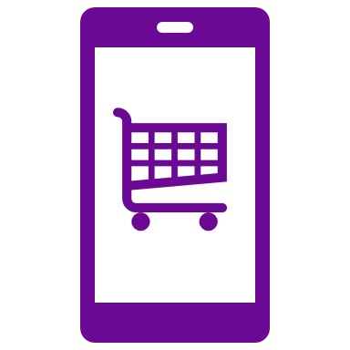







Appendix 5: Case in Point - Welspun
About the Brand
Global leader in home-textiles
4th & 7th in towel & Sheets respectively
#11
Brands under their portfolio
Growth Drivers
Project WAVE
Key Partnerships
Brand
Learning Program supporting Change Transformation Business Strategy.
Aided Scaling of E-Commerce Vertical.
Introduced a virtual showroom and revamped existing brands
Created a strong Technology Back-end
COE Org Model WAVE Academy Capability
Emerging Businesses
E-Commerce
Value Enablers
Key Affiliations
Digitization
Innovation
ESG

Slide 14







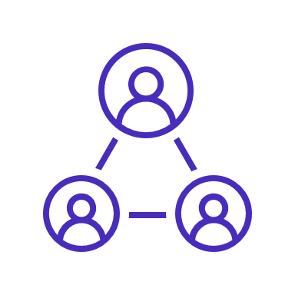





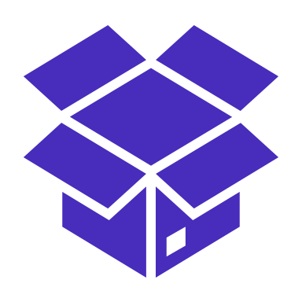

Appendix 6: D2C alignment with business model
Offerings
Before
With D2C
Traditional Products
Traditional Products
New Products
Complementary access/ Devices
Value-added services
Subscription models
Channels
Owned Website
Flagship stores
Peer-to-peer
Retailers
E-tailers
Retailers
E-tailers
Apps
Fulfilment
To warehouse
To warehouse
Last Mile Delivery to consumer
Consumer Case return
Click n Collect
To 3PLs
To 3PLs

